Slide 1
Smart Taiwan - Rolmes
Dec. 08, 2016

Slide 2
Business Concept
RolmesApp is a professional-grade iOS app that allows every law enforcement user to record, track, maintain, collaborate and report on all the data within a criminal investigation or a crime scene.
Target User : law enforcement

Slide 3
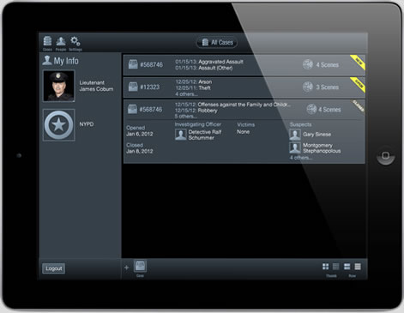
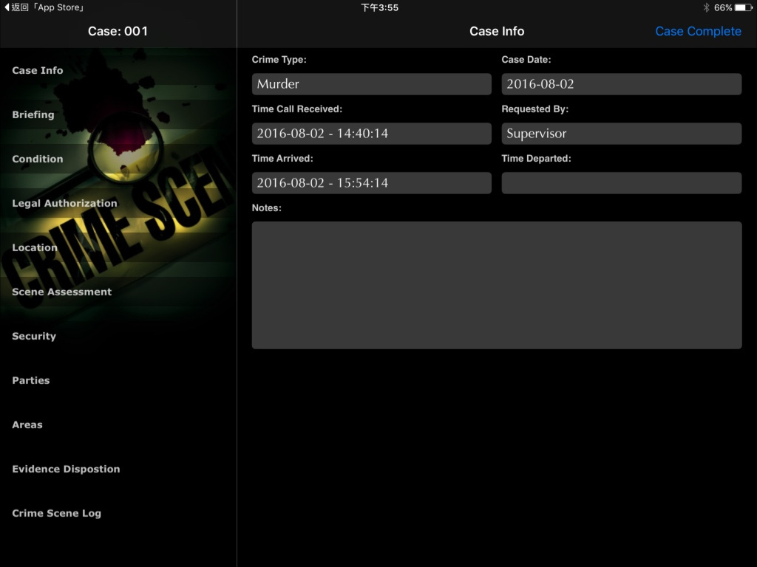
Competition
Jointed Development
Free Trial/ Price by functions
Updated: Sep 12, 2016
Language: English
Production by
Visionations
Jointed Development
Dr. Homeyer (FBI Senior Executive)
Jeff Gurvis (analyst)
Company Location
Denver, US
Being Used By
> Local police departments in California, Virginia, and Tennessee
> State-wide agency (does not wish to be identified)
> 2014 Trial : Washington D.C. Department of Forensic Science.
CrimePad
Jointed Development
Free Trial/ Price by functions
Updated: Dec 21, 2015
Language: English
Production by
Prime Forensics
Jointed Development
Oklahoma Police officer
Criminalist Administrator
Company Location
Oklahoma, US
Smart Scene

Slide 4
Comparison
Smart
Scene
Crimepad
Rolmes
Rolmes-APP
Case Assignment
Checklist - Patrol officer
Checklist - Detective
Case Info
GPS
Crime Scene Investigation
Contact
Personnel
Evidence
Photo
Video
Hardware - Bar Code
Hardware - Sensor
Crime scene reference guides
Photo Annotating/Sketch
Speech to Text
Real-Time Sync
Bar Code
Report Generating
iOS
Android
Windows Phone
Web Browser
Price
Y
Y
Y
Y
Y
Y
Y
Y
Y
Y
Y
Y
base on functions
Y
Y
Y
Y
Y
Y
Y
Y
Y
49.99
Y
Y
Y
Y
Y
Y
Y
Y
Y
Y
Y
Y
Y
Y
Y
Y
Y
Y
Y
Y
Y
Y
Y
Y
Y
Y
Y
Y
Y
Y
Y
Y
Y
Y

Slide 5
Product Structure
Rolmes Web
Rolmes APP
sync
Get data
Customer System

Slide 6
Schedule
Feb. 2017
Beijing team
involve
July 2017
Product release
New Jersey
Jan. 2017
Neil Business trip
June 2017
Business trip
Dec. 2017
Product release
3rd Version Rolmes
2^{ed} Version Rolmes
1st Version Rolmes
Web / Engine
Rolmes
3^{td} Version APP
2^{ed} Version APP
1st Version APP
Web / Engine
APP
Jan. 2017
Website Demo
Mobile resource
involve
April 2017
Dubai Conference
Dr. Lee meeting
June 2017
User Testing
Aug. 2017
IAI Conference U.S.A
Pay customer

Slide 7
Pricing strategy
10 cases trail for free(include deleted items)
1 case trail for free
Free trail for a month
$ 9.99 / month - 1 user for standard version (storage limited)

Slide 8
Risks
Mobile Hardware Restriction
Disc is too small to store large amount of crime scene images
Hard to integrate with camera or other devices
Domain Knowledge
Follow FBI procedures might be unsuitable for all areas
Information Security
Data could be accessed through public cloud
Power Authority
William might have different opinions

Slide 9
Key Issues
When will the man power involved
What is the scope of Rolmes for first released version
Web / Engine version
Who will verify the correctness of domain knowledge

Slide 10
Resource Requirements
List requirements for the following resources:
Personnel
Technology
Finances
Distribution
Promotion
Products
Services

Slide 11
Appendix
Reference supplementary materials and resources

